Slide 1
Cyclistic Case Study
SHIVAM MISHRA
20/08/2022

Slide 2
CONTENTS
INTRODUCTION
PROBLEM
INSIGHTS
SOLUTIONS
CONCLUSION

Slide 3
INTRODUCTION
Here in this case study I will try to solve the business problem with the help of data analysis process:ask, prepare, process, analyze, share, and act.
The company called Cyclistic, a bike sharing company in Chicago. The company wants to maximize the number of annual memberships i.e. to convert their casual riders to annual members.

Slide 4
How do annual members and casual riders use Cyclistic bikes differently?
We will try to figure out through data how they use bikes differenty

Slide 5
INSIGHTS
Members use more bike then casual riders
Members use less riding time vs casual riders use it for longer duration.
Casual generally use bike for leisure
Members more likely to use it for their regular work like for riding to office, gym, etc.

Slide 6
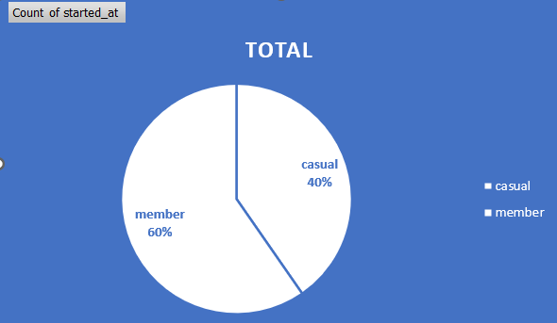
CASUAL VS MEMBER
The percent of casual rider are 40%
The percent of member are 60%

Slide 7
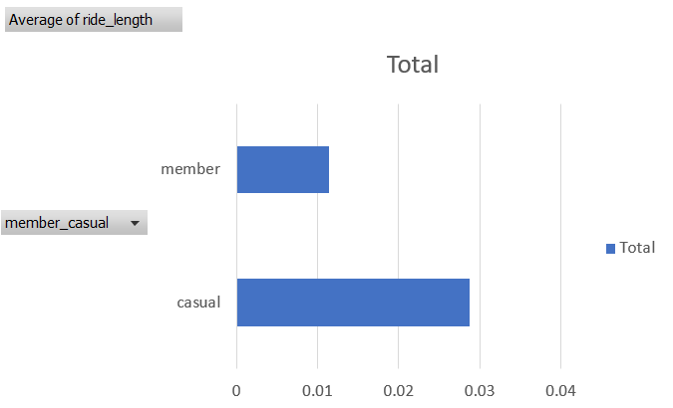
RIDE LENGTH
On average the casual rider rides longer distance compare to members.

Slide 8
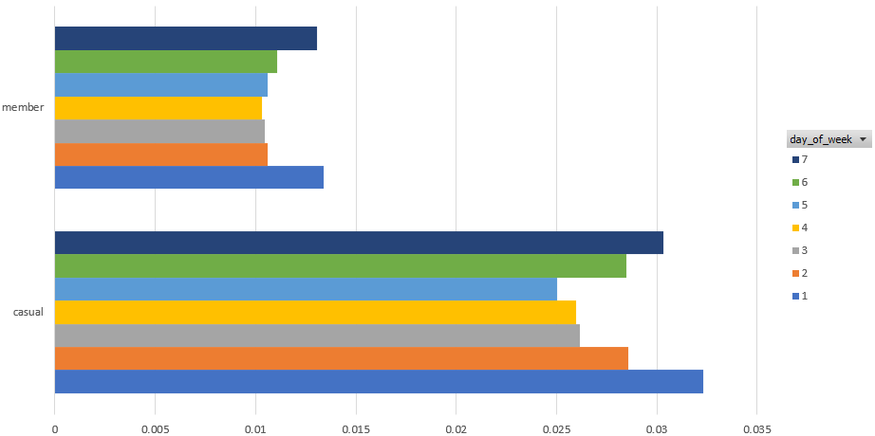
Day of week they use more
As we can see on the bar chart both the riders generally more use it on weekends.

Slide 9
SOLUTIONS
AS we can see in last figure in presentation about the day which they use more bike, on average they take more ride on Saturday and Sunday compare to usual days. Team can advertise our annual membership plan on weekends by offering free ride and explain it to them the benefit about taking the annual member plan. They could lower the price of annual member plan for new users for limited time period and they could advertise about it in smaller to medium scale in effective way

Slide 10
CONCLUSIONS
In this whole business problem I used ask, prepare, process, analyse in effective way. I used SQL to join these datasets, spreadsheet to analyse it, the tableau and excel for visualizing the data and R studio for documenting and tried these whole phase of analysing ,visualizing, processing in R.

Slide 11
ANY QUESTIONS?
THANK YOU!

